Slide 1

Stock Market Analysis and Prediction

Slide 2
LITERATURE REVIEW
STOCK MARKET PREDICTION VIA MULTI-SOURCE MULTIPLE INSTANCE LEARNING.
PREDICTING STOCK PRICE DIRECTION USING SUPPORT VECTOR MACHINES.
STOCK MARKET PREDICTION USING HISTORICAL DATA ANALYSIS.
A SURVEY ON STOCK MARKET PREDICTION USING SVM.

Slide 3
RESEARCH questions:
Is it profitable to invest on a single stock for a long time?
Is it profitable to invest on all the stocks equally ?
What is the major attribute affecting the stock value?
Is it better to invest on long term basis or invest in regular intervals ?

Slide 4
Is it profitable to invest on a single stock for a long time?
Facebook
Average Investment is $173
Probability of getting profit
With respect to investment
period
Period | Prob(profit)
1 | 0.6
3 | 0.6
6 | 0.66
9 | 0.59
12 | 0.54

Slide 5
Is it profitable to invest on a single stock for a long time?
Apple
Average Investment is $188
Probability of getting profit
With respect to investment
period
Period | Prob(profit)
1 | 0.65
3 | 0.73
6 | 0.83
9 | 0.74
12 | 0.83

Slide 6
Is it profitable to invest on a single stock for a long time?
Amazon
Average Investment is $1547
Probability of getting profit
With respect to investment
period
Period | Prob(profit)
1 | 0.68
3 | 0.69
6 | 0.73
9 | 0.93
12 | 0.87

Slide 7
Is it profitable to invest on a single stock for a long time?
Netflix
Average Investment is $294
Probability of getting profit
With respect to investment
period
Period | Prob(profit)
1 | 0.6
3 | 0.66
6 | 0.66
9 | 0.66
12 | 0.75

Slide 8
Is it profitable to invest on a single stock for a long time?
Netflix
Average Investment is $294
Probability of getting profit
With respect to investment
period
Period | Prob(profit)
1 | 0.6
3 | 0.66
6 | 0.66
9 | 0.66
12 | 0.75

Slide 9
Is it profitable to invest on a single stock for a long time?
Google
Average Investment is $1106
Probability of getting profit
With respect to investment
period
Period | Prob(profit)
1 | 0.65
3 | 0.63
6 | 0.76
9 | 0.81
12 | 0.79

Slide 10
Is it profitable to invest on a single stock for a long time?
STOCK | 3 MONTHS | 6 MONTHS | 1 YEAR | Probability of profit for 1 year
FACEBOOK | $1.91 | $5.53 | $9.75 | 0.54
APPLE | $11.17 | $26.02 | $44.00 | 0.83
AMAZON | $103.05 | $200.66 | $351.71 | 0.87
NETFLIX | $20.30 | $37.51 | $56.42 | 0.75
GOOGLE | $27.99 | $73.95 | $122.37 | 0.79

Slide 11
Is it profitable to invest on all the stocks equally ?
STOCK | P(1 month) | P(3 months) | P(6 months) | P(9 months) | P(12 months)
FACEBOOK | 0.6 | 0.6 | 0.66 | 0.59 | 0.54
APPLE | 0.65 | 0.73 | 0.83 | 0.74 | 0.83
AMAZON | 0.68 | 0.69 | 0.73 | 0.93 | 0.87
NETFLIX | 0.6 | 0.66 | 0.66 | 0.66 | 0.75
GOOGLE | 0.65 | 0.63 | 0.76 | 0.81 | 0.79
Equal Investment | 0.64 | 0.66 | 0.73 | 0.75 | 0.75

Slide 12
Is it profitable to invest on all the stocks equally ? For investment of 1000 dollars
Company | 1 month | 3 months | 6 months | 9 months | 12 months
Facebook | 7.954545 | 10.85227 | 31.90751 | 40.63953 | 57.35294
Amazon | 23.0405 | 65.30418 | 129.9611 | 180.3539 | 237.1612
Apple | 20.15 | 57.34749 | 139.8925 | 202.2222 | 247.191
Netflix | 24.60768 | 68.28891 | 128.1526 | 163.4812 | 196.0185
Google | 9.207048 | 24.76106 | 67.10526 | 92.60829 | 113.5158
Equal Investment | 16.99195 | 45.31078 | 99.40379 | 135.861 | 170.2479

Slide 13
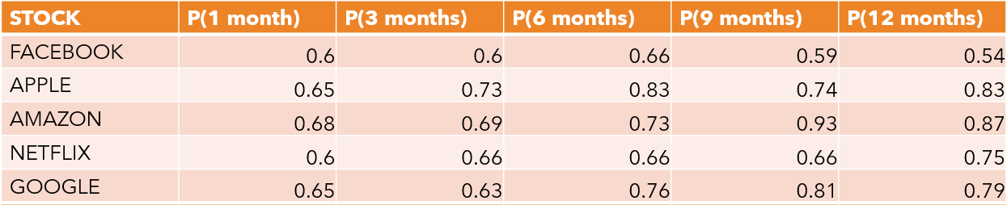
What is the major attribute affecting the stock value?
Period of investment and point of time play an important role in affecting the stock value

Slide 14
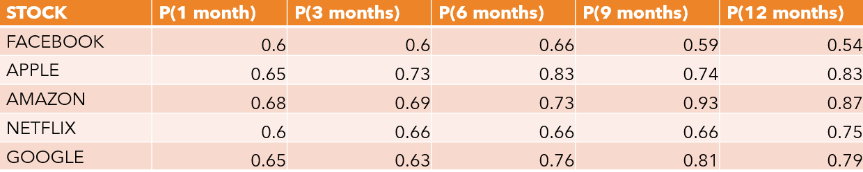
Is it better to invest on long term basis or invest in regular intervals ?
It is better to invest on long term basis as the probability of gaining profits is high for long term investments

Slide 15
LINEAR REGRESSION
Linear regression attempts to model the relationship between two variables by fitting a linear equation to observed data.
One variable is an explanatory variable, and the other is the dependent variable.

Slide 16
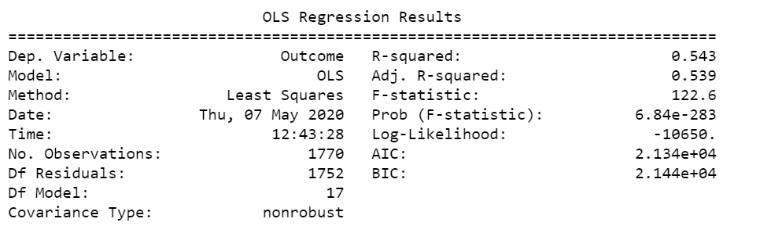
LINEAR REGRESSION

Slide 17
DECISION TREE CLASSIFICATION
Decision tree builds classification or regression models in the form of a tree structure.
It breaks down a dataset into smaller and smaller subsets while at the same time an associated decision tree is incrementally developed.
The decision tree classifier predicts whether the investment is a gain or a loss.

Slide 18
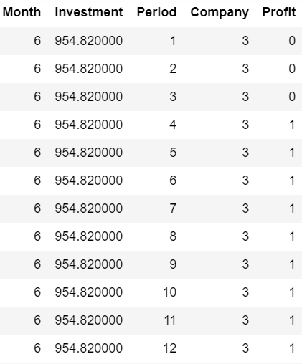
DEPLOYMENT OF THE MODEL
Decision tree model is built in Jupyter notebook
The built model is dumped into pickle
The pickle model is deployed to local server using Flask

Slide 19
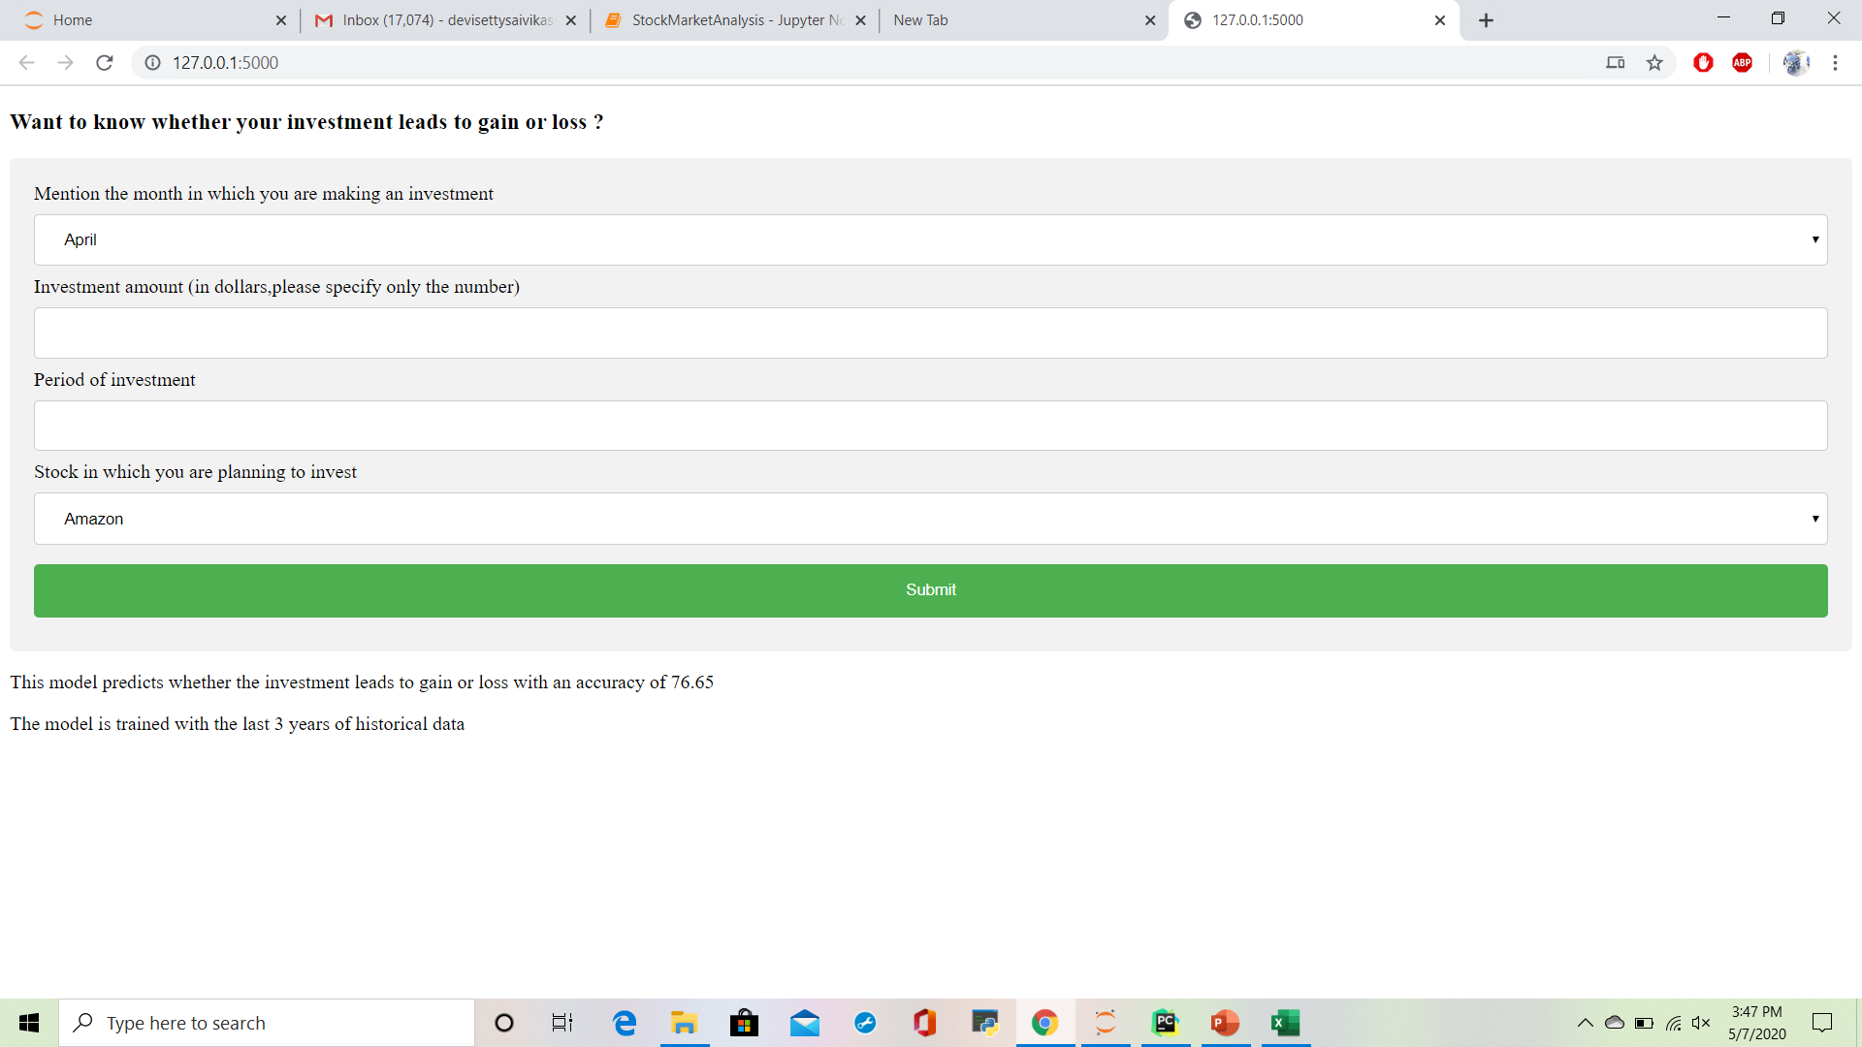
RESULTS

Slide 20
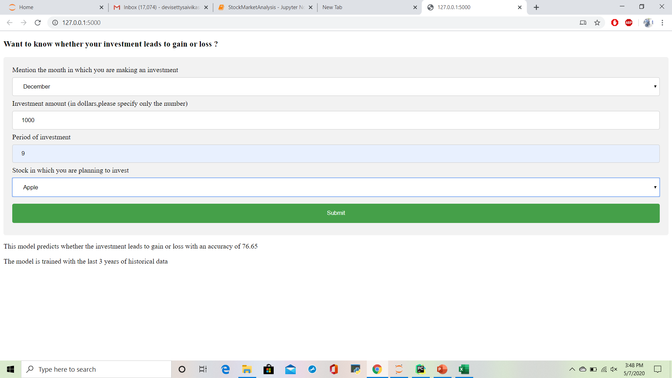
RESULTS

Slide 21
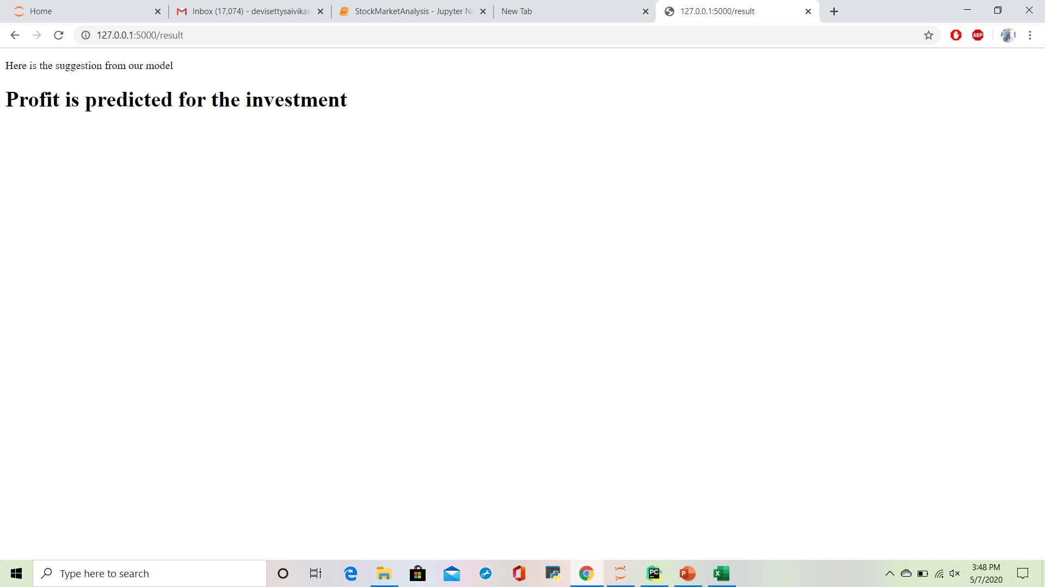
RESULTS

Slide 22
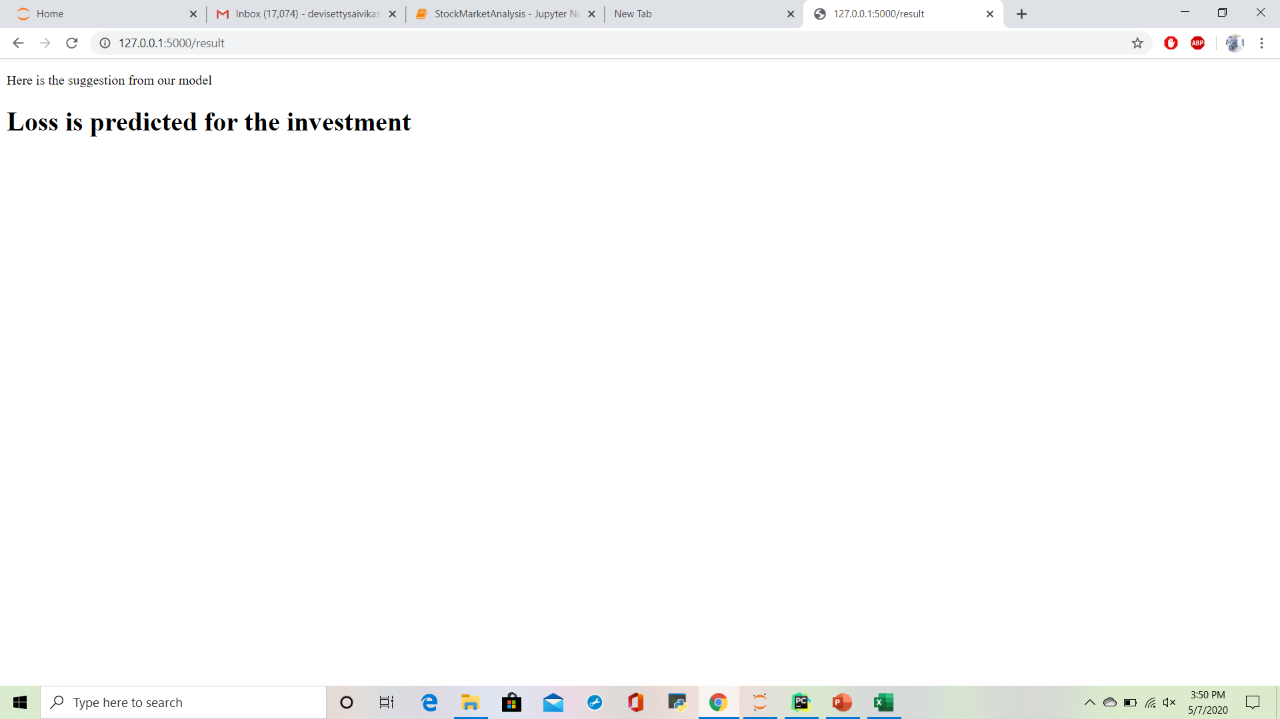
RESULTS

Slide 23
Limitations:
Stock market values are highly unpredictable because of its dynamic nature
We cannot use historical data more than three years
In stock market the correlation between the attributes doesn’t exist

Slide 24
Future work:
Improving the accuracy of the model by increasing the historical data by defining a proper method to consider the inflation rate
Suggesting the investors to invest in a profitable way based on their investment and period of investment
Extending the work to other top stocks in the market

Slide 25
THANK YOU

